Slide 1
Main streamlines in the social rights' praxis of the Slovene Constitutional Court
www.us-rs.si

Slide 2
Three main points
Social rights (second generations rights) are the rights of a positive status… are numerous – but how to determine their scope?
Human dignity and the value of each individual is the essence of human (social) rights
Message?: Does the Cons. Court safeguard (only) the elites?

Slide 3
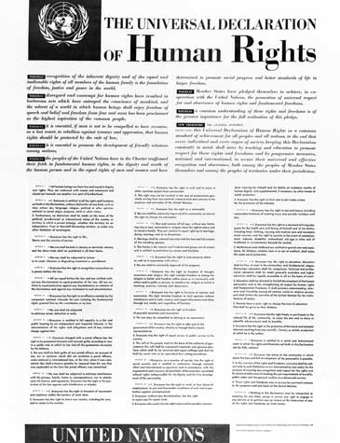

Slide 4
Like ECtHR also the CC assesses the appropriateness of state measures
ECtHR:
Von Volsem v Belgium (14641/89, unpaid elec. invoices)
Pančenko v Latvia (40772/98, social distress)
O‘Rourke v GB (39022/97, homelessness)
Budina v Russia (45603/05, insufficient pension)
Minimum core concept: Is the applicant attained the requisite level of severity to engage Article 3!

Slide 5
Slovene Constitutional Court assesses the appropriateness within the proportionality test and in the test of reasonableness). But giving a clear content to the sensitive social rights is rather difficult. It is necessary to establish whether the essence of the right is at stake.
Case: U-I-146/12 Fiscal Balance Act – a mandatory retirement at certain age is an appropriate measure in order to balance the public expenses (but not discriminatory)
Case: U-I-186/12 Fiscal Balance Act - the state can decrease the level of the retiring allowance due to the state-based economic reasons
Case Up-360/05 – a right to the retiring allowance shall – in its essence – be at least the level of social security, but latter…
Case U-II-1/11: Retiring allowance – shall amount more than a simple life-level minimum, it shall amount to certain social minimum- taking into account paid contributions. A life-level minimum is less than social-level minimum.

Slide 6
Human dignity
closely connected with diff. human rights (freedom of speech, state based procedures, migrations etc)
vast amount of cases touches also the dignity in social cases
Case U-I-64/14 - Right to a home
Case: U-I-110/15, Up-568/15 - Social Assistance Benefits Act is not unconstitutional - condition not to dispose with the immovable
when it comes to a question of the „capability“ of the state
Case ABC (Up-93/18, pending, only a legal question is presented)

Slide 7
Is the Cons. Court safeguarding (only) the elites?
Decision that Confiscation of Proceeds of Crime Act is uncosnt. in a part which enables it to be retroactively applied (U-I-6/15)… give rise to public opinion that CC safeguards the elites only
CC (cannot) calculate (iudex non calculat), and its rulings can also imply messages that decreases the trust of the public
Obiter dicta messages are rare

